Slide 1

EXPENSE TRACKER
Aditi Singh
Bhoomi Abichandani
Eshita Arora
Keerthana Peddireddy
Snigdha Sree Gaddamanugu
Tanmayee Rudraraju

Slide 2

Problem
Traditional expense tracking methods can be cumbersome and error-prone.
Paper receipts and manual data entry are time-consuming and prone to human error.
Lack of real-time data access hinders efficient expense management.

Slide 3
Contents of Expense Tracker
Manager
Employee
The Manager is like the administrator
The home welcomes the manager, contains redirection link to expense table
Contains the list of expenses of employees that can be accepted or rejected
->
->
All the employees under a manager have the same view
The expenses history will be displayed as the landing page
The employees can add their expenses, including amount, type and more
->
->

Slide 4
Introduction
This application features distinct user interfaces for employees and managers.
Employees can submit expense reports electronically with ease.
Managers have a central hub to review, approve, or reject expense reports.
Real-time data access promotes informed decision making.

Slide 5


Technologies and techniques used
01
02
03
04
DotNet
React
Specifically used for the backend and API creation
Used for frontend to create a responsive UI.
SSMS
AJILE Methodology
SQL Server Management Server was used for creating the database
Values flexibility, and collaboration, delivers a product quickly

Slide 6
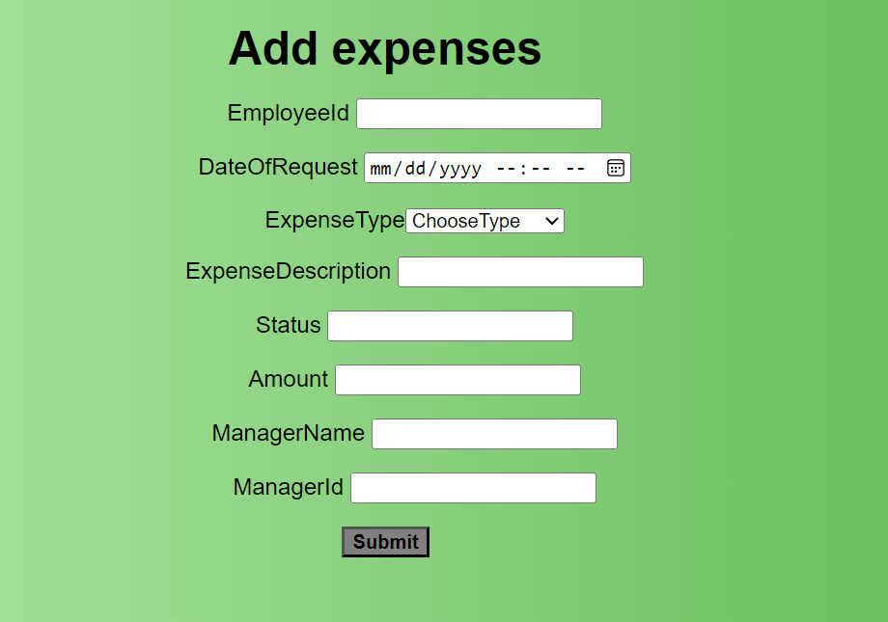
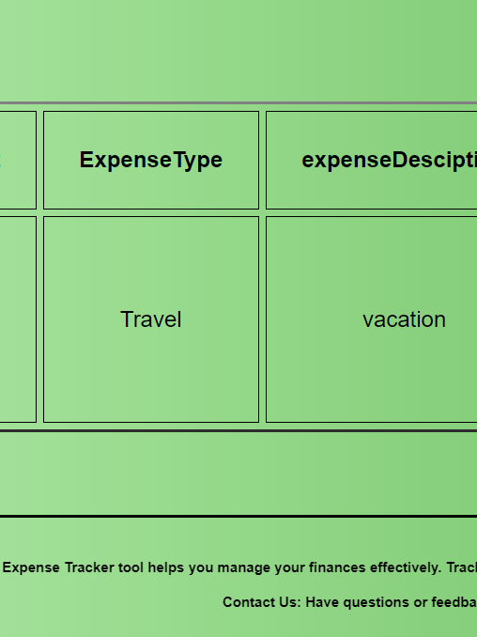

Responsive Pages

Slide 7
Database Snapshots
This can be the part of the presentation where you introduce yourself, write your email…

Slide 8
Expense Tracker Screenshot
Put here

Slide 9
Functionalities
Login and Register
Add Expenses
Approve or Reject
We have a Login and Registration form for authorization, based on which the view will be decided.
We have a Employee view to display a form that can be used to add expenses that in turn can be reflected on the manager’s interface for his approval
The manager will have the responsibility to Approve or Reject the expense request created by the employee based on the budget and reasoning.

Slide 10
Other Functionalities
…
CRUD Operation
The employee can also see the history and status of orders , and perform edit and delete operations
…
There is also a navigation bar that can navigate the user to different pages like home, about and logout
NavBar
…
The forms also have proper validation about passwords
Validation

Slide 11
THANK YOU

